Slide 1
Searching and sorting algorithms
Module 2
Chapter 7

Slide 2
Before we start
https://jolson615.github.io/createasearchalgorithm/index.html
https://shorturl.at/FHPY6

Slide 3
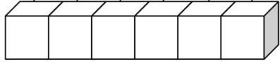


Search Algorithms
A search algorithm is useful when we are trying to value a specific value inside an array.
Array
Search algorithm
Index of the value
Target

Slide 4
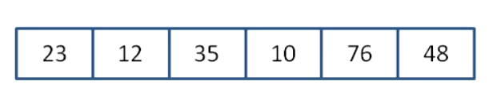
Linear search
The linear search algorithm consists in looking for the search key from sequentially.
searchKey
76
array
Found!
Return index 4!

Slide 5
Linear search
The linear search algorithm consists in looking for the search key from sequentially.
searchKey
100
array
Not found!
Return -1!

Slide 6
Linear search
Linear search can be very slow, because in its worst case scenario, the value does not exist in the array.

Slide 7
Linear search
public static int findElement(int[] array, int target){
for(int i=0; i<array.length; i++){
if (array[i] == target)
return i;
}
return -1;
}
When the value is found, then the index in which the element is found will be returned
If the value is not found, -1 will be returned

Slide 9
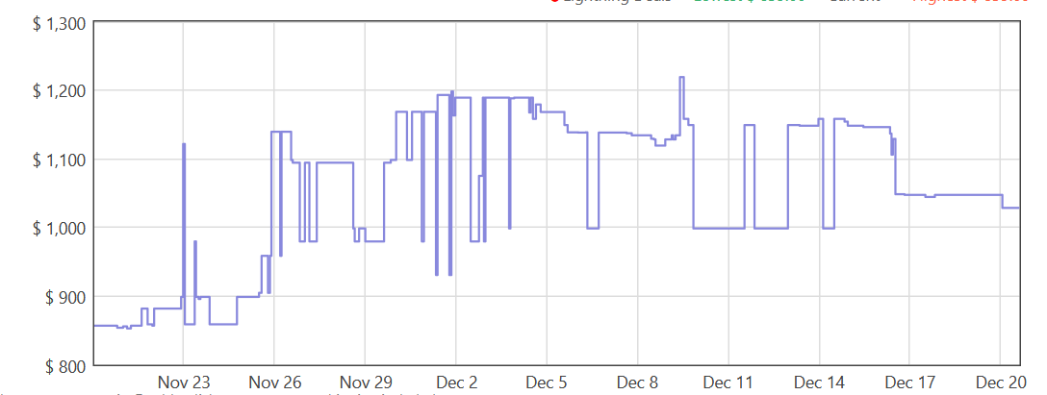

Exercise
Design a java method that returns the smallest price a product has been sold for in Amazon.

Slide 10
public static void main(String[] args) throws Exception {
double[] alexaPrices = {100, 156, 65, 100, 100, 100, 45, 45, 45, 65, 100};
int bestPrice = findMinPrice(alexaPrices);
System.out.println("The best price for the product is: " + alexaPrices[bestPrice]);
}
public static int findMinPrice(double[] prices) {
//if array is invalid, return -1
if (prices == null || prices.length <= 0) {
return -1;
}
//start by assuming the smallest price will be in index 0
int indexOfSmallestPrice = 0;
//check against every array position
for(int i=1;i<prices.length; i++) {
if (prices[indexOfSmallestPrice] > prices[i]) {
//if a smaller price is found, then replace old value
indexOfSmallestPrice = i;
}
}
return indexOfSmallestPrice;
}

Slide 11
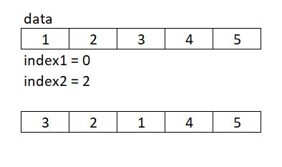
Exercise - Swap two array elements
Code a method that swaps the contents of two array positions.
Inputs:
int [] data
int index1
int index2
Outputs:
None
Antes
Después

Slide 12
Sorting Algorithm
A sorting algorithm is used to place all elements in an array in some specific order
Alphabetical
Date
Size
Color
There are many sorting algorithms in computer science, some more efficient than others.

Slide 13
Selection sort

Slide 14
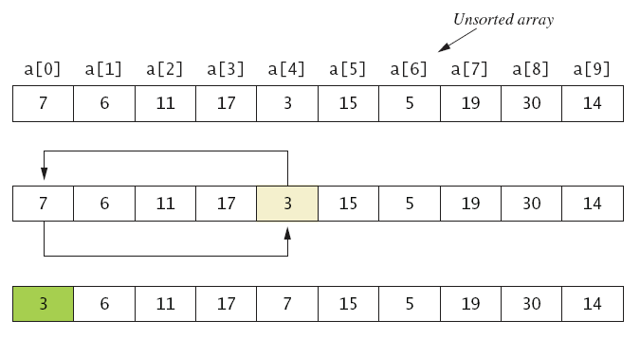
Selection Sort
Figure 7.5a

Slide 15
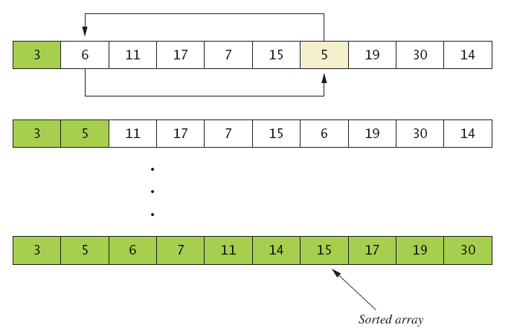
Selection Sort
Figure 7.5b
. . .

Slide 17
public static void selectionSort(int[] array){
//check valid input array
if (array == null)
return;
//Iterate over every position, trying to find the smallest element and
// place it on index i
for(int i = 0; i<array.length-1; i++){
//Starting from i (since all elements before i are already sorted),
// look for the smallest array element, and store its index in min.
// Assuming initially the smallest element is i, we will store it on min.
int min = i;
//Well begin our internal loop on i+1, since min was alreay initated with i
for(int j=i+1; j<array.length; j++){
//If we encounter a smaller element than array[min], we store its index on min
if (array[j] < array[min]){
min = j;
}
}
//Swap the contents of array[i] with array[min]
int temp = array[min];
array[min] = array[i];
array[i] = temp;
}
}

Slide 18
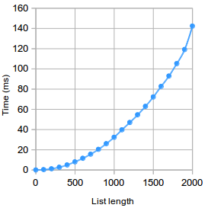
Selection Sort
Selection sort is one of the simpler sorting algorithms, but it can be very inefficient for large arrays!

Slide 19
Bubble Sort

Slide 20
Bubble Sort
BubbleSort is a sorting algorithm that works by swapping unordered adjacent elements.
The algorithm will finish once all elements are in order.

Slide 21
Bubble Sort
First Run
( 5 1 4 2 8 ) → ( 1 5 4 2 8 )
Swap 5 and 1
( 1 5 4 2 8 ) → ( 1 4 5 2 8 )
5>4, swap places
( 1 4 5 2 8 ) → ( 1 4 2 5 8 )
5>2, swap places
( 1 4 2 5 8 ) → ( 1 4 2 5 8 )
5<8, no swap

Slide 22
Bubble Sort
Second run
( 1 4 2 5 8 ) → ( 1 4 2 5 8 )
( 1 4 2 5 8 ) → ( 1 2 4 5 8 )
Since 4>2, we swap the values
( 1 2 4 5 8 ) → ( 1 2 4 5 8 )
( 1 2 4 5 8 ) → ( 1 2 4 5 8)

Slide 23

Bubble Sort
Third run
( 1 2 4 5 8 ) → ( 1 2 4 5 8 )
( 1 2 4 5 8 ) → ( 1 2 4 5 8 )
When a run is completed without doing any swaps, then the array is already ordered
( 1 2 4 5 8 ) → ( 1 2 4 5 8 )
( 1 2 4 5 8 ) → ( 1 2 4 5 8)

Slide 25
//Bubble Sort
public static void bubbleSort(int[] array){
//check valid input array
if (array == null)
return;
//This flag will turn "true" every time a swap has been performed
// Its initial value is true
boolean flagSwap = true;
//This loop will control every pass we do through the array.
// If no swaps are performed on a pass, then flagSwap will be false
// and finish the loop
for(int i = 0; i<array.length-1 && flagSwap; i++){
flagSwap = false;
//Loop through the array up to array.length-1-i.
// Everything after array.length-i is already sorted.
// We subtract 1 to avoid overflowing array[j+1]
for(int j=0; j<array.length-1-i; j++){
//Swap the contents of array[j] with array[j+1]
if (array[j+1] < array[j]){
int temp = array[j+1];
array[j+1] = array[j];
array[j] = temp;
flagSwap = true;
}
}
}
}

Slide 26
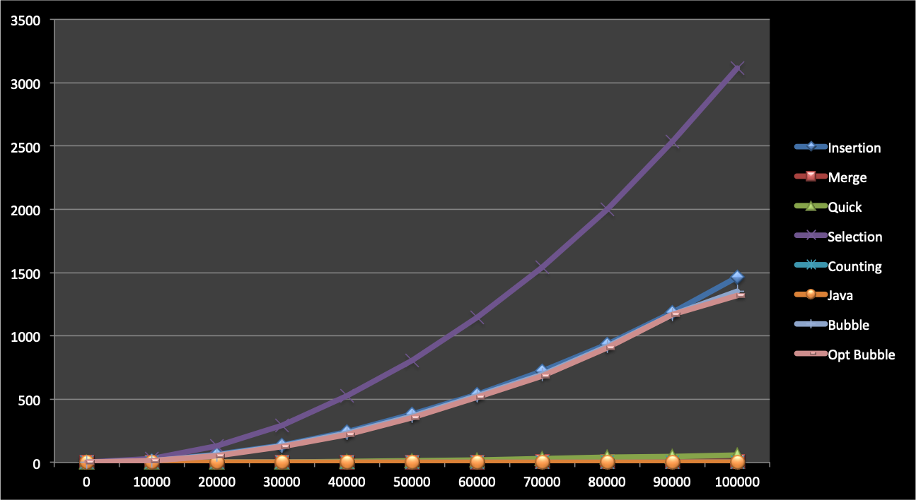
Bubble Sort
In the best-case scenario (the array is already ordered), the algorithm will finish as soon as the first pass is completed.
In the worst-case scenario, (the array is ordered from largest to smallest), each pass does n-1 swaps and n-1 comparisons.

Slide 27
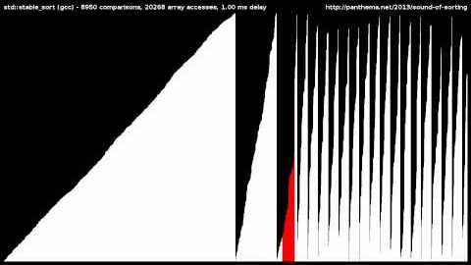
Sorting algorithms

